Slide 1
Maker Camp Arduino
Nancy Rochford, Becky Oberhauser, Ryan Brock

Slide 2
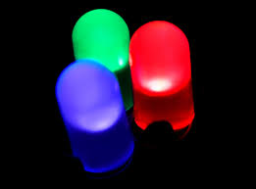
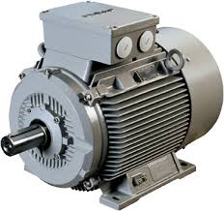
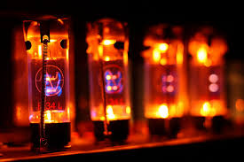
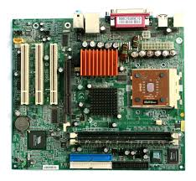
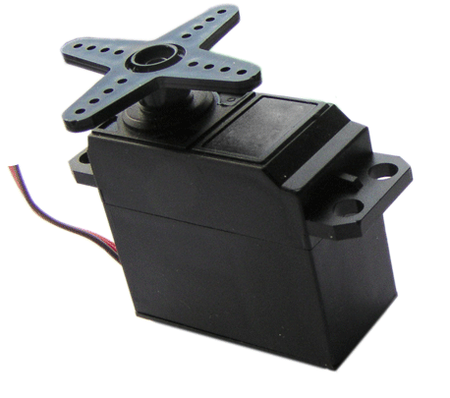
Hardware

Slide 3
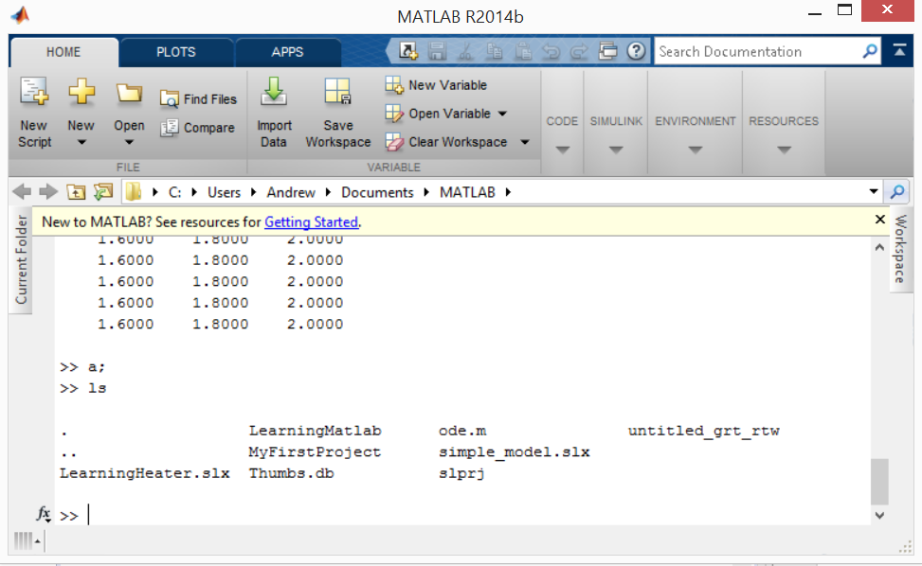
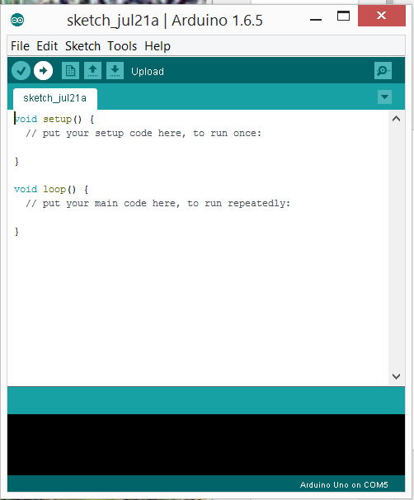
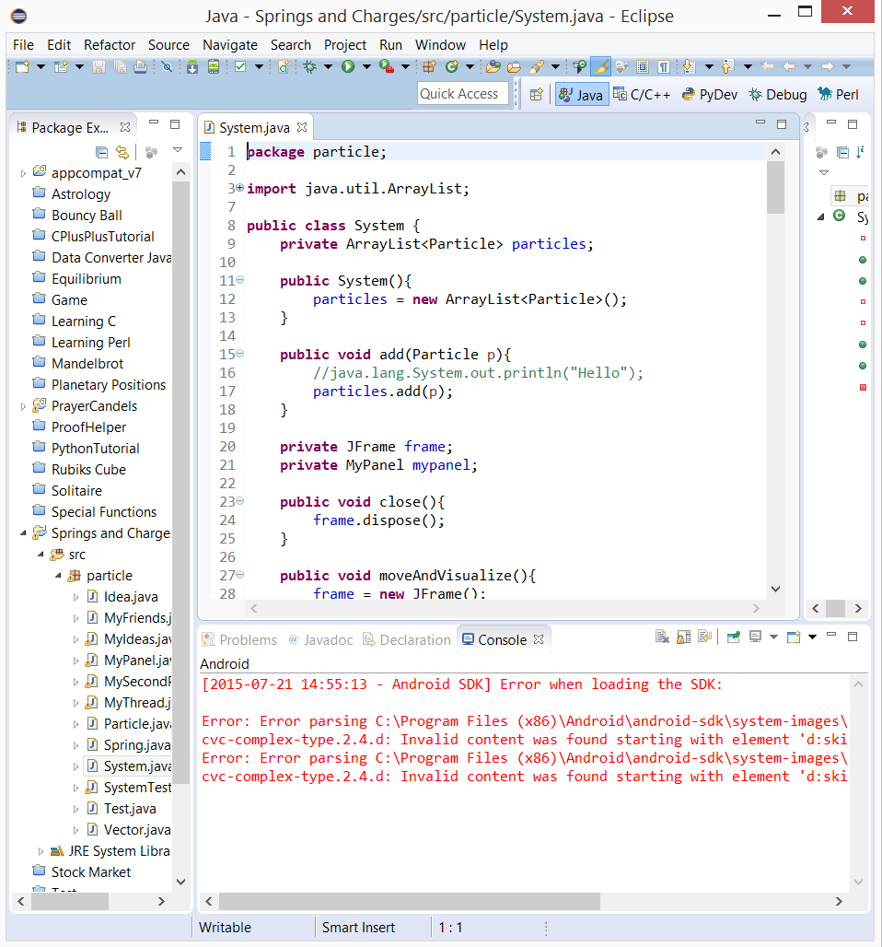
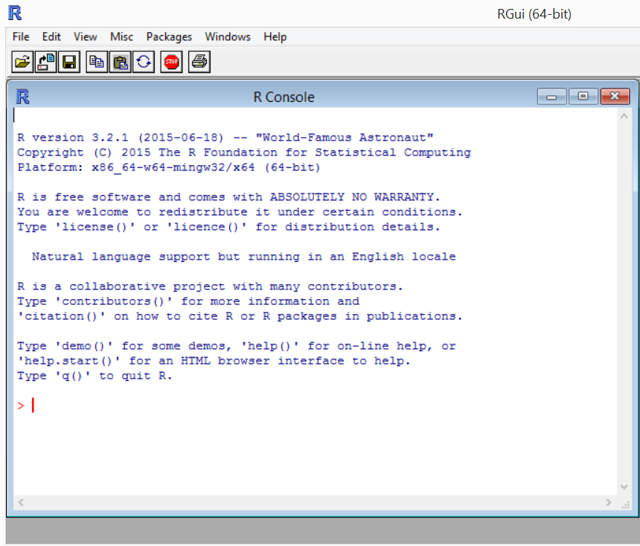
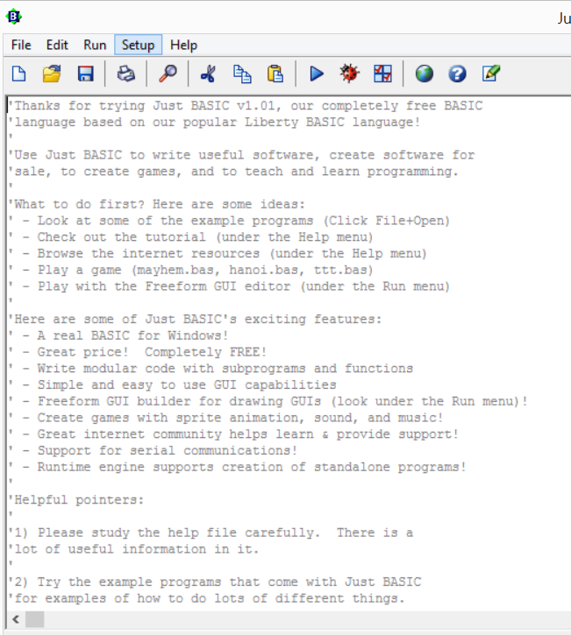
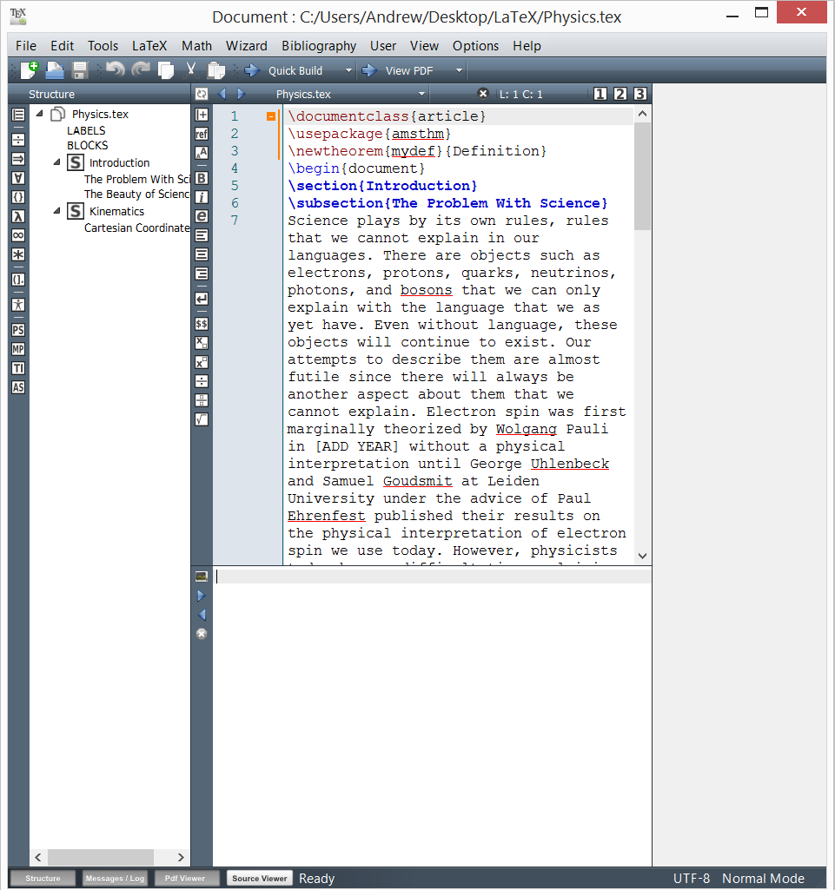
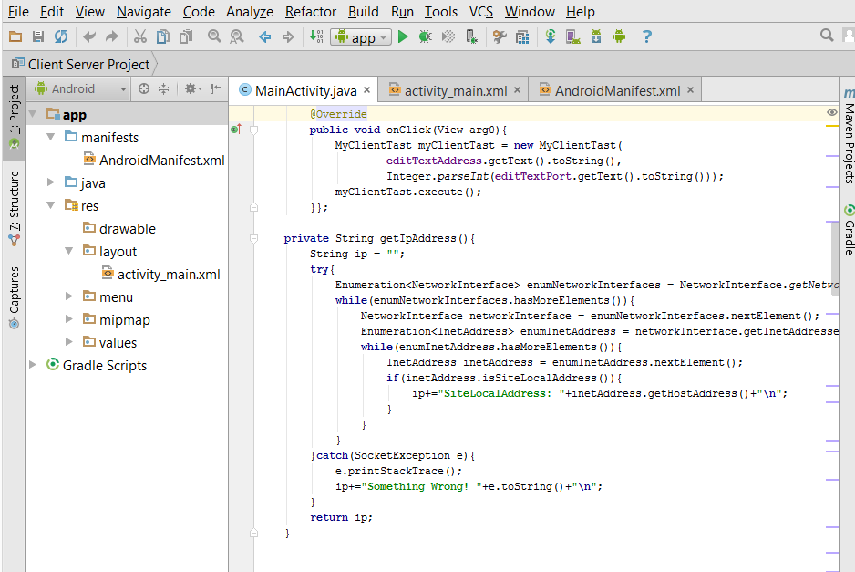
Software

Slide 4

The Arduino Uno

Slide 5
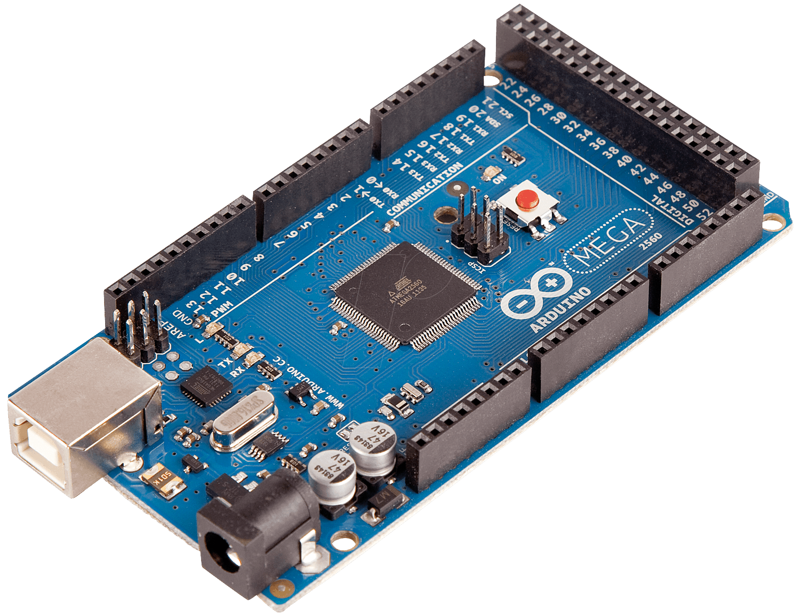
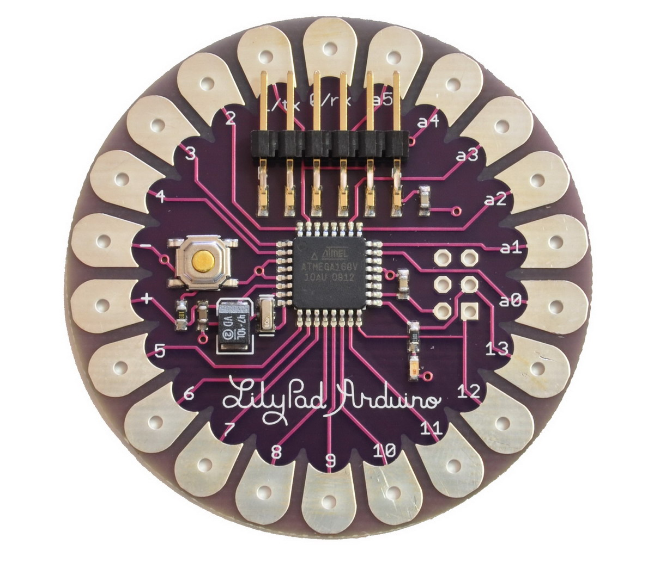
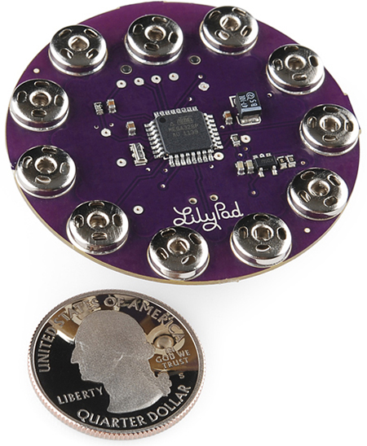
The Arduino Family

Slide 6
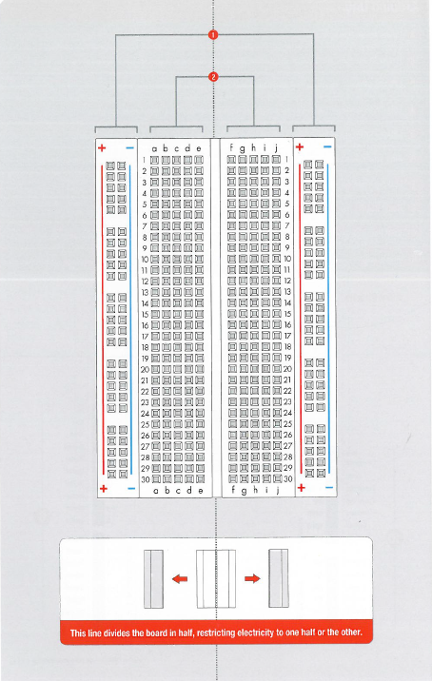

Slide 7
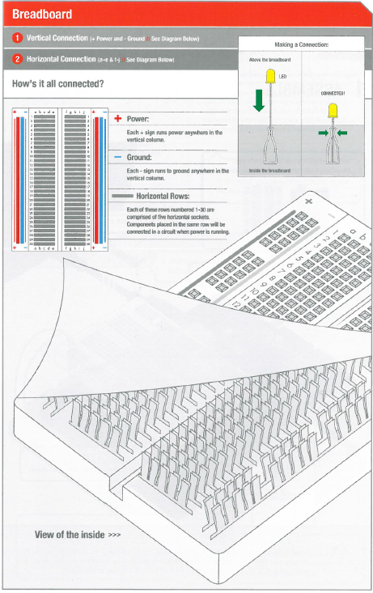

Slide 8
Breadboard
Where is C:19?

Slide 9

Just Like Battleship

Slide 10
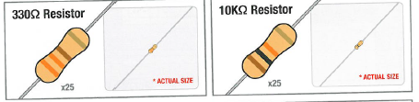
Be careful to use the correct resistor!

Slide 11
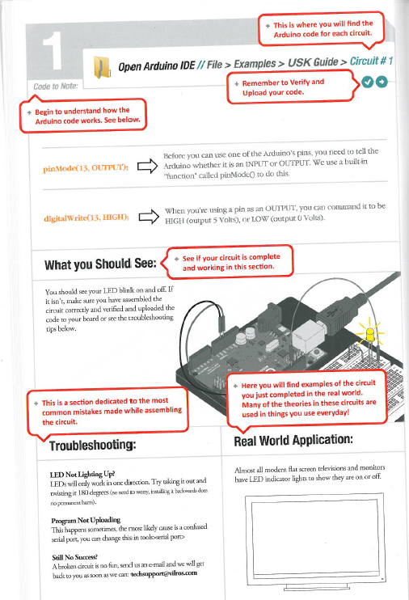
Guide sections have lots of help

Slide 12
Begin Circuit 1!
20 Minutes

Slide 13
Alterations
Turn the LED around so the longer pin is in C2 instead of C3 (then switch it back)
Alter the time the LED is on and off so that is on for 3 seconds and off for ½ second
Change the pin from pin 13 to pin 2
Use 2 330 Ω resistors in place of the 10K Ω resistor
Replace the 2 330 Ω resistors with a single 10K Ω resistor
Alter the program so that the LED blinks on and off for 1 second, then 2 seconds, then 3 seconds, then 4, then 5, then repeats starting with 1 second

Slide 14
Circuit 1 lessons
A program is called a “sketch”
A sketch:
contains setup() area
contains loop() area
uses “/* */” or “//” for comments
uses “;” to separate instructions
Commands used:
pinMode(13, OUTPUT);
digitalWrite(13, HIGH);
delay(1000);

Slide 15
Circuit 1 lessons
Higher Resistance reduces the LED brightness
The ‘D’ in LED stands for diode which means current can only travel in one direction

Slide 16
Circuit 1 questions
Why do we need the resistors in series with the LED?
What happens each time we add a new one in series or swap it with a much higher resistance?
What would happen if we moved the code from loop() and put it all into setup()?
Did anyone use a loop to modify the program for the last alteration?

Slide 17
Why is one lead longer?

Slide 18
Begin Circuit 2!
15 Minutes

Slide 19
Measurement
Use the multi-meter to read the voltage and resistance across the potentiometer

Slide 20
Circuit 2 lessons
Arduino has digital and analog pins
Commands used:
analogRead(sensorPin);
Variable resistance LED brightness

Slide 21
Circuit 2 questions
Can you describe the difference between the digital and analog pins?
What else can we do with the potentiometer?

